Slide 1
MSc Creative Computing
# MSc Creative Computing
Practice as Research — Lecture 8
Critical framing — refining your argument
Mick Grierson — Creative Computing Institute, UAL
Black text on white. ~19 slides. Slide text lean; detail in the speaker notes.
1

Slide 2
Practice as Research
Critical Framing
Refining your argument
Lecture 8 of 8 — Practice as Research
Mick Grierson, Creative Computing Institute, UAL
2
Notes:
This is the last lecture, and it's the synthesis. Everything so far has been a component — a question, a gap, a method, documentation, an artefact, an exhibition. Today is assembly: how those parts become a single argument that means something to someone other than you. The hidden agenda of this lecture is voice — helping students hear that they have one, and that their critical perspective is the thing that turns a project into a contribution.

Slide 3
The whole arc
Weeks | What we built
1 | Research = edge + hypothesis + test
2 | How practice produces knowledge
3 | Finding the gap
4 | Choosing methods
5–6 | Reflection and documentation
7 | Exhibition vs research output
8 | Tying it together into an argument
Today: how do all of these become one coherent claim that's meaningful for others?
3
Notes:
Put the whole journey on one slide so students can see how far they've come. Each week added a component. The danger now is that they have seven disconnected pieces — a cool artefact, some references, a method, a pile of documentation — and no through-line. The job of the final write-up is to forge a through-line. That through-line is the argument.

Slide 4
From project to argument
You don't have a research project until you can state, in one sentence:
> "I claim that X, because Y, as shown by Z."
X = your contribution (the new thing you know)
Y = your reasoning (why it follows)
Z = your evidence (artefact, documentation, study, analysis)
Everything you've made and written is in service of that one sentence.
4
Notes:
This is the spine of the lecture. If a student can't fill in X, Y, and Z, they don't yet have an argument — they have activity. Make them try it out loud. Most will struggle with X (the claim) because it's tempting to describe what they *did* rather than what they now *know*. "I built a system that..." is not a claim. "Building this system demonstrates that..." is getting closer. The claim is the knowledge, not the activity.

Slide 5
The "So what?" test
Booth, Colomb & Williams (The Craft of Research) propose the most useful question in research:
"So what?"
I made a generative audio system. So what?
It produces outputs in real time from gesture. So what?
It shows that embodied, low-latency control changes how performers relate to generative material — a relationship the offline-generation literature can't account for. ← there's the contribution.
Keep asking "so what?" until you hit something the field would care about.
5
Notes:
The "so what?" ladder is the single most practical tool in this lecture. Students stop too early — they think the artefact is the answer. Push them down the ladder: each "so what?" forces them from description toward significance. The bottom of the ladder is where the contribution lives. If they can't answer "so what?" at all, that's diagnostic — either the gap was never real, or they haven't yet understood what their own work reveals. Either way, better to find out now.

Slide 6
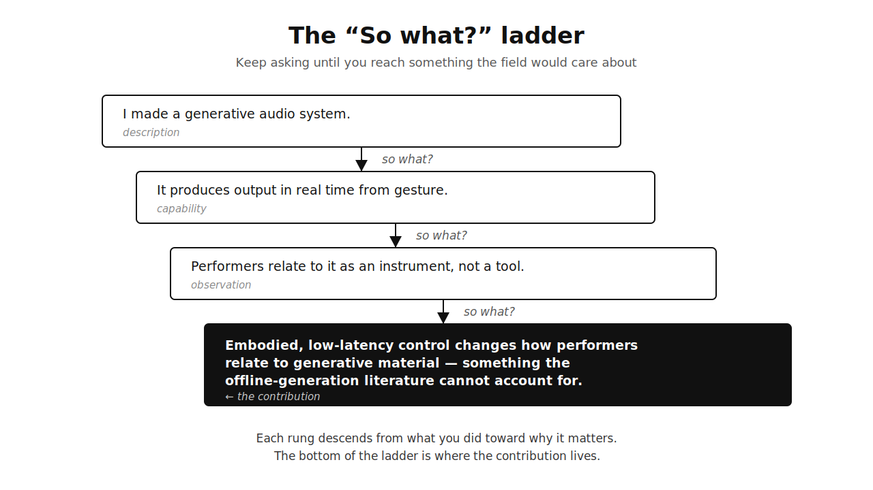
6
Notes:
Full-screen diagram. Walk down it rung by rung, pausing on each "so what?" Let the descent do the work — by the time you reach the black box, students should feel the difference between describing what they did and stating why it matters.

Slide 7
The shape of an argument
Toulmin (1958) gives us the parts:
Claim — what you assert (your X).
Grounds — the evidence (your Z: artefact, study, documentation).
Warrant — the link that explains why the grounds support the claim.
The warrant is the part students forget. It's the reasoning that connects "here's my evidence" to "therefore my claim holds."
7
Notes:
Toulmin's model is worth ten minutes. Claim and grounds are intuitive — students get "here's what I say" and "here's my evidence." The warrant is the invisible bridge, and it's where weak arguments collapse. Example: claim — "this system enables a new kind of improvisation"; grounds — "three performers used it and described feeling 'in dialogue' with it"; warrant — "self-reported sense of dialogue is a meaningful indicator of a qualitatively different performer relationship, because..." If the warrant is shaky, the evidence doesn't actually support the claim. Naming the warrant forces you to check your own reasoning.

Slide 8
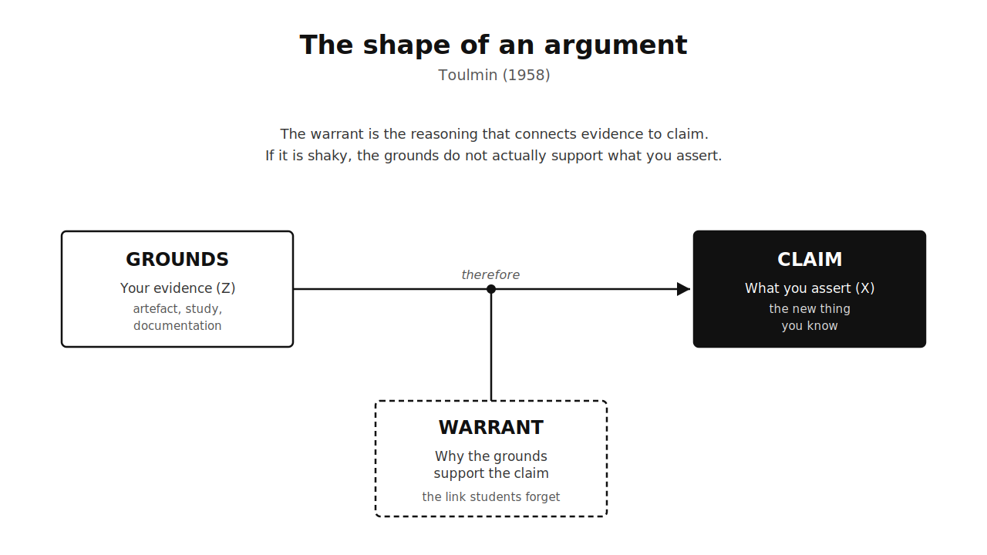
8
Notes:
Full-screen diagram. Point to the warrant box specifically — it's the part that's drawn dashed and sitting underneath because it's the part students leave implicit. Make them say their own warrant out loud for their project: "my evidence supports my claim because…"

Slide 9
Synthesis is not summary
Bringing your work together is synthesis, not summary.
Summary: "Here's what I read. Here's what I made. Here's what happened." (A list.)
Synthesis: "These ideas, this making, and these results together point to something none of them shows alone." (A claim.)
Synthesis is the move from components to contribution.
9
Notes:
This distinction matters because students default to summary — it's safer and easier. A summary recounts; a synthesis argues. The synthesis is where you, the researcher, add value: you're the one who sees that the literature, the artefact, and the user responses, taken together, reveal something. Nobody else has all three in view at once. That combination is your unique vantage point — and it's the basis of your voice.

Slide 10
Where your contribution comes from
Recall the five kinds of knowledge from Week 2. Your contribution usually lives in one or more:
Procedural — a new technique or method
Experiential — what it's like to encounter or use the work
Tacit — embodied skill and judgement, made partly explicit
Propositional — a testable claim
Critical — a new way of framing a problem
Name which one(s) you're claiming. "My contribution is critical and procedural: a new technique, and a new way of thinking about what it's for."
10
Notes:
Tie back hard to Week 2 — this is the payoff of that framework. Students who can name the *type* of their contribution write much sharper claims. A procedural contribution and a critical contribution need to be argued differently and evidenced differently. Many creative computing projects are procedural + critical: you built a thing (procedural) and in doing so reframed a question (critical). Saying so explicitly is half the battle.

Slide 11
Finding your voice
"Voice" sounds mystical. It isn't. Your voice is:
the questions you find worth asking,
the connections you see that others miss,
the stance you take on what matters and why.
It emerges from your particular mix of skills, references, and obsessions. You don't invent it — you notice it, then sharpen it.
11
Notes:
This is the part students find hardest to believe applies to them — they think "voice" is for established artists and senior academics. It isn't. Voice is just the consistent perspective that comes from being a specific person with a specific history looking at a specific problem. A student from a music background and one from a games background will see the same generative system completely differently — and both perspectives are valuable. The point is to stop apologising for your perspective and start trusting it. Your reflective notes (Weeks 5–6) are where your voice is already visible — the things that surprised *you*, the connections *you* made.

Slide 12
Voice is a position, not a style
Your voice isn't about flowery writing. It's about taking a defensible position.
Weak: "There are many interesting perspectives on generative music, and all have merit."
Strong: "The dominant framing of generative music as automation misses what matters: these systems are most interesting as instruments, not composers. My work proceeds from that position."
A position can be argued with. That's what makes it research.
12
Notes:
Students confuse "academic" with "neutral and hedged." The opposite is true — a strong piece of research takes a clear position and defends it. Hedging everything ("on the one hand... on the other...") is not balance, it's an absence of voice. You can acknowledge counter-positions (you should — that's slide 11) while still committing to one. The commitment is the voice. The willingness to be wrong in a specific, interesting way beats being vaguely right about everything.

Slide 13
Refining: the reverse outline
A concrete tool for tightening your argument:
1. Write your draft.
2. In the margin, summarise each paragraph in one sentence — what does it claim?
3. Read only the margin notes.
4. Do they form a logical argument? Or a list of topics?
If the margin notes don't flow, your argument doesn't either — no matter how good the prose.
13
Notes:
Reverse outlining is the most useful revision technique most students have never been taught. It separates *what you said* from *how you said it*. Beautiful prose can hide a broken argument; the reverse outline exposes it. If paragraph 4's claim doesn't follow from paragraph 3's, you've found a gap in your reasoning. Recommend they do this once on a full draft — it's tedious and transformative. It also reveals paragraphs that claim nothing (cut them) and claims that appear twice (merge them).

Slide 14
Argue with yourself
A strong argument anticipates the strongest objection — and answers it.
Ask of your own work:
What would a sceptic say?
What's the most generous version of the opposing view?
Where is my evidence weakest, and how do I handle that honestly?
Naming a limitation is a strength, not a confession.
14
Notes:
This is Booth/Colomb/Williams on acknowledging and responding to reader reservations. Students think admitting weakness loses marks. The opposite: an examiner who spots a limitation you didn't acknowledge concludes you didn't see it. An examiner who sees you name it and handle it concludes you understand your own work deeply. "With 8 participants this is exploratory, not generalisable — but the consistency of the responses suggests a pattern worth a larger study" is a confident, honest move. Steelmanning the opposition (the *most generous* version, not a strawman) is what separates a thoughtful researcher from a defensive one.

Slide 15
A worked synthesis: from pieces to claim
Imagine the components of a finished project:
Gap: generative audio is studied offline; real-time embodied control is under-explored.
Artefact: a low-latency gesture-to-synthesis system.
Method: construction + technical eval (latency) + 3 performers, interviewed.
Documentation: process log, annotated portfolio, demo video.
The synthesis (the claim): "Treating generative models as real-time instruments rather than offline composers reveals an embodied, dialogic mode of performance that the dominant offline framing cannot account for — demonstrated by a working low-latency system and performers' consistent reports of 'playing with' rather than 'using' it."
One sentence. Every component earns its place in it.
15
Notes:
Walk through how each component maps into the claim. The gap justifies *why* it matters. The artefact and latency eval are the grounds for "working, real-time." The interviews are the grounds for "dialogic." The framing ("instruments not composers") is the critical contribution — the voice. This is the moment the lecture's abstract machinery becomes concrete. Encourage students to draft their own version of this sentence and then check: does every part of my project show up somewhere in it? If a component doesn't, either it's not load-bearing, or the claim isn't capturing everything it should.

Slide 16
A second example: a critical/curatorial claim
Not every contribution is a built system. Consider a project that is mostly analysis through making:
Gap: text-to-image models are evaluated technically (bias benchmarks) but rarely interrogated aesthetically through sustained practice.
Practice: a series of generated image-sets probing how models render contested subjects.
Synthesis: "Systematic artistic prompting functions as a research method that surfaces models' encoded assumptions in ways quantitative benchmarks cannot — the distortions are not noise but evidence."
The contribution here is critical and methodological, not a piece of software.
16
Notes:
Include this to counter the assumption that "contribution = system." For the more art-leaning students, the contribution is often a way of seeing or a way of inquiring, evidenced by a body of work. The claim still has the same shape (X because Y as shown by Z), but Z is a curated series of outputs plus critical reading, not a benchmark. The "distortions are evidence, not noise" move is the kind of reframe that constitutes a genuine critical contribution — it changes what counts as a finding.

Slide 17
Reflecting on the process, not just the product
Your write-up should reflect on how the work developed, not only where it ended up.
What did you believe at the start that turned out to be wrong?
Which surprise changed your direction? (Your Week 5–6 notes hold these.)
What would you do differently with another three months?
This is the iterative cyclic web (Week 2) made visible — and it's evidence of a researcher who learns.
17
Notes:
Connect to Smith & Dean and to the reflective documentation from Weeks 5–6. A write-up that presents only the polished endpoint looks like luck; one that traces the trajectory — including the wrong turns — looks like research. The "what would you do with more time" question is not filler: it demonstrates that you can see past your own project to the next one, which is exactly what situates your work as a contribution others can build on. This is also where the process log pays off enormously — students who logged have this material; students who didn't are reconstructing from memory.

Slide 18
Self-assessment: is your argument working?
Run your draft through these checks:
Can I state my claim in one sentence? (Slide 3)
Does it survive "so what?" (Slide 4)
Is there a warrant linking evidence to claim? (Slide 5)
Does my reverse outline flow? (Slide 10)
Have I answered the strongest objection? (Slide 11)
Is my position clear, not hedged into mush? (Slide 9)
If yes to all six, you have an argument, not just a project.
18
Notes:
This is a practical checklist students can take away and apply to a draft tonight. Frame it as a tool, not a hurdle. Each item maps to a slide they can return to. Suggest they run the checklist, fix the worst failure, and run it again. The six checks are roughly ordered by leverage — fixing the one-sentence claim usually fixes several downstream problems at once, because a muddy claim is what makes the warrant and the outline muddy too.

Slide 19
Common mistakes at the end
Describing, not claiming. "Here's what I made" with no "so what?"
Burying the contribution on page 30 instead of stating it up front.
Hedging away your voice until no position remains.
Hiding limitations instead of owning them.
Listing instead of synthesising — seven components, no through-line.
19
Notes:
These are the failure modes that turn good work into weak submissions. The "burying the contribution" one is worth dwelling on: state your claim early and clearly, then spend the rest of the document earning it. Examiners shouldn't have to excavate your contribution. Each of these maps to something we've covered — they're not new sins, just the old ones showing up at the finish line.

Slide 20
Where this goes next
The argument you build here is the same shape you'll use for:
a conference paper or journal article,
a funding application,
a portfolio or exhibition statement,
a pitch for a job, a commission, or a collaboration.
"I claim X, because Y, as shown by Z" scales from a 60-credit project to a career.
20
Notes:
End by widening the lens. This isn't just about passing the module — it's a transferable structure. Every time they need to convince someone their work matters, this is the move. The students heading into industry will pitch ideas; the ones heading into research will write papers and grants; the ones heading into independent practice will write statements and applications. The skill is identical. That's why this module exists.

Slide 21
The whole thing, in one breath
1. Find an edge (the gap).
2. Make something that investigates it.
3. Pay attention to what making reveals.
4. Document it so others can follow.
5. Decide what you now know that the field didn't.
6. Say it clearly, defend it honestly, and show your evidence.
That's practice as research.
21
Notes:
The closing slide — the entire eight weeks compressed into six lines. Read it slowly. This is the thing you want them to remember in two years when they're staring at a blank document trying to write up a project. Everything else was detail in service of these six steps. End on the definition: practice as research is not making with a write-up bolted on; it's making *as* a way of knowing, made legible to others through a clear, defended argument.

Slide 22
References
Booth, W. C., Colomb, G. G., Williams, J. M., Bizup, J. & FitzGerald, W. T. (2024). *The Craft of Research*, 5th ed. University of Chicago Press.
Toulmin, S. (1958). The Uses of Argument. Cambridge University Press.
Smith, H. & Dean, R. T. (eds.) (2009). *Practice-led Research, Research-led Practice in the Creative Arts.* Edinburgh University Press.
Borgdorff, H. (2011). "The Production of Knowledge in Artistic Research." In Biggs & Karlsson (eds.), *The Routledge Companion to Research in the Arts.* Routledge.
Candy, L. (2006). *Practice Based Research: A Guide.* CCS Report, UTS.
Nelson, R. (2013). *Practice as Research in the Arts.* Palgrave Macmillan.
22

